Slide 1

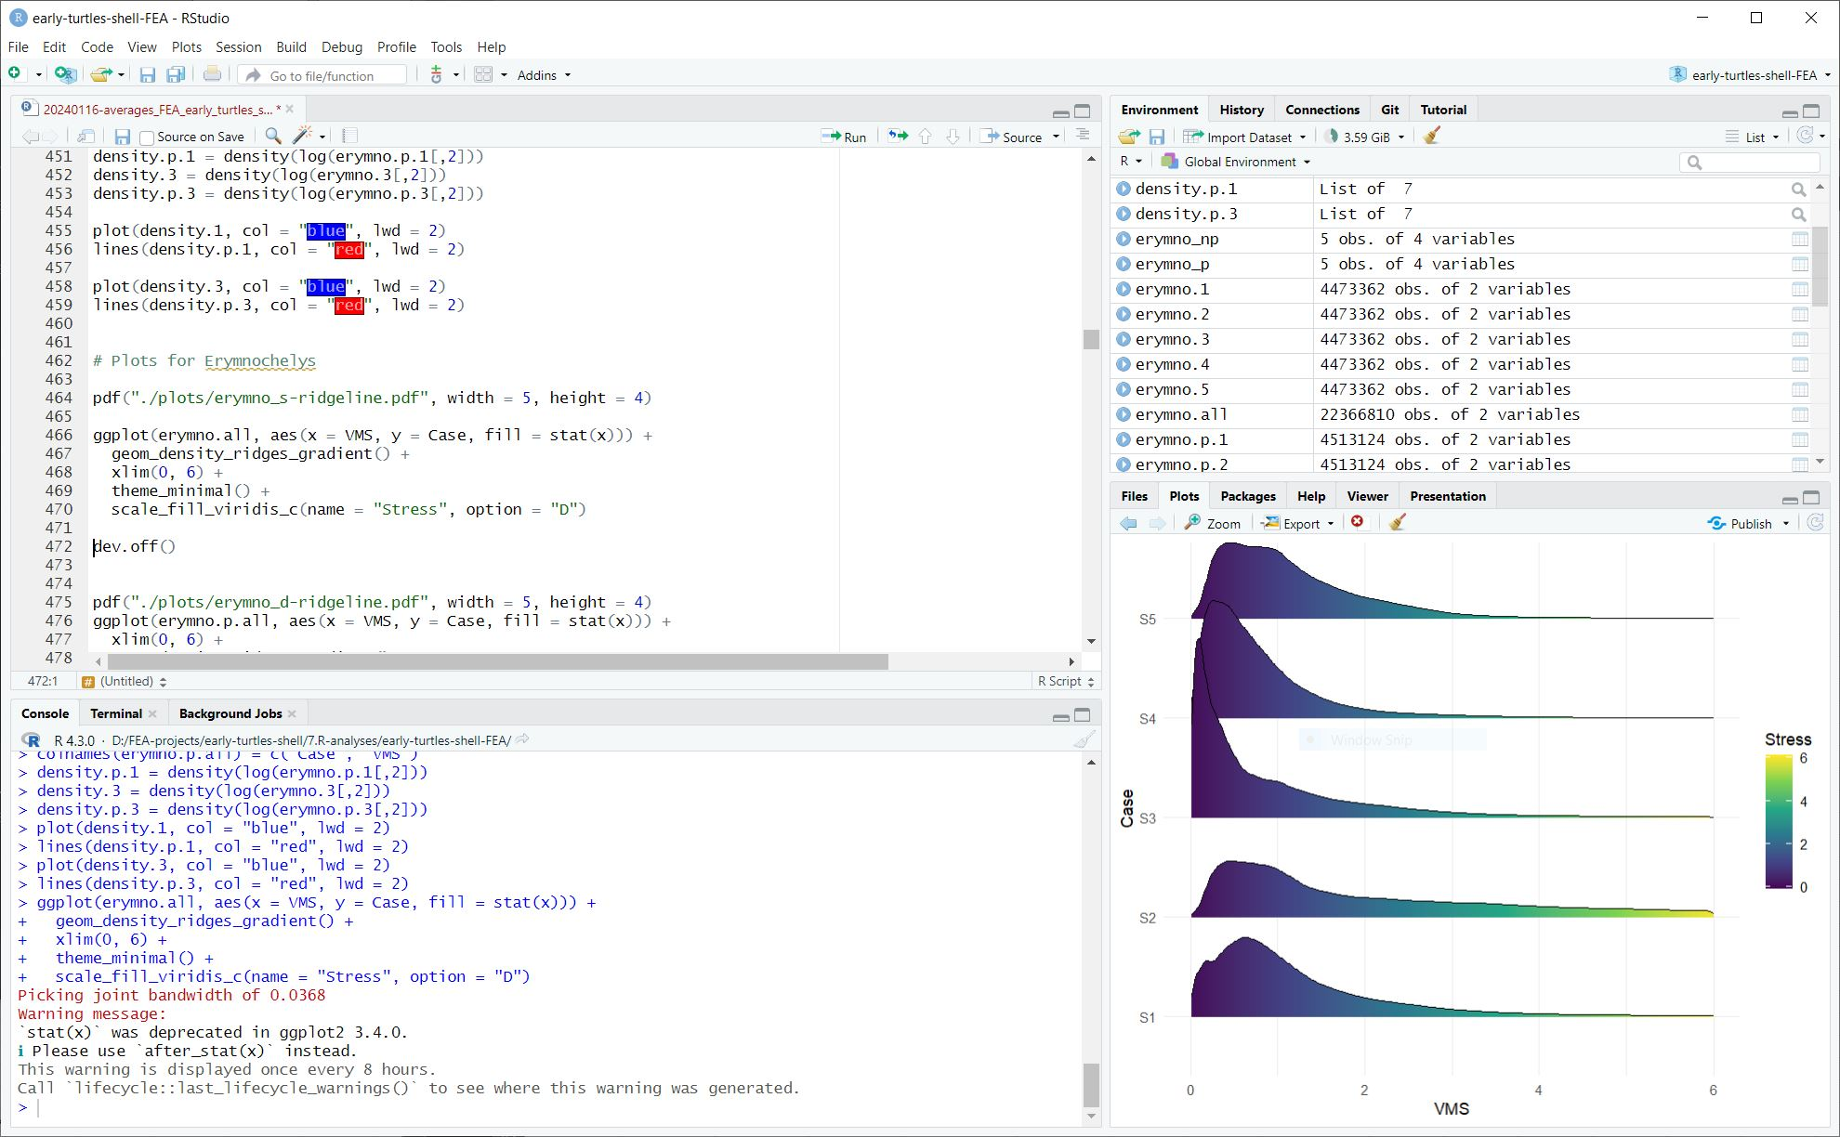

Introduction to
Dr. Gabriel Ferreira
gabriel.ferreira@ifg.uni-tuebingen.de
WS 2025/26
Geow-M317_325-21-16 Data Analysis and Modeling Methods
01.2026

Slide 2
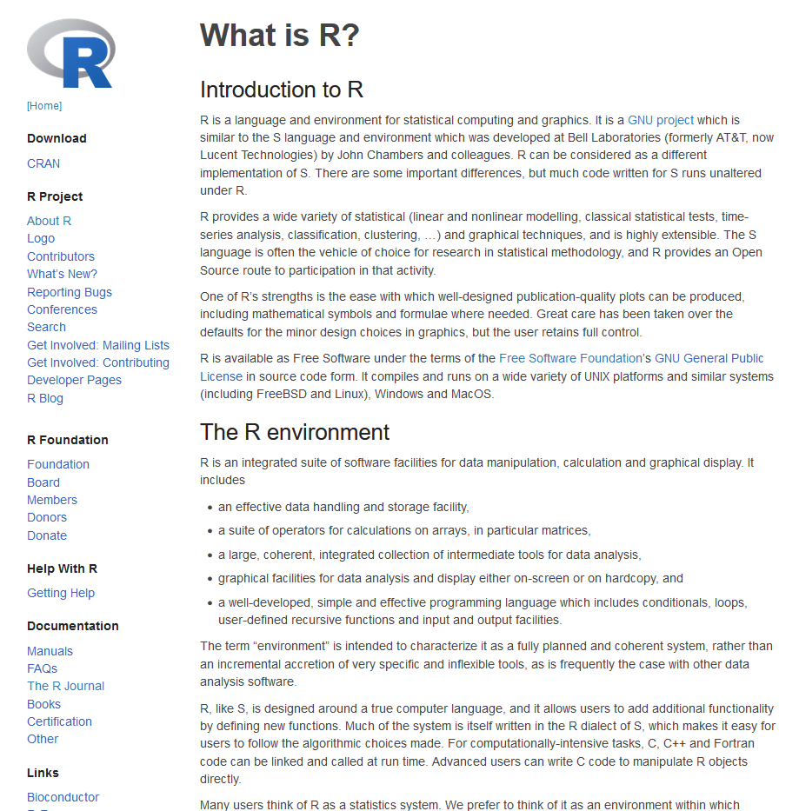
What is R?
R is:
a language and environment for statistical computing and graphics
an integrated suite of software facilities for data manipulation, calculation and graphical display
highly extensible
open source & free
www.r-project.org

Slide 3
What is R?
“One of R’s strengths is the ease with which well-designed publication-quality plots can be produced, including mathematical symbols and formulae where needed. Great care has been taken over the defaults for the minor design choices in graphics, but the user retains full control.”
“Many users think of R as a statistics system. We prefer to think of it as an environment within which statistical techniques are implemented. R can be extended (easily) via packages. There are about eight packages supplied with the R distribution and many more are available through the CRAN family of Internet sites covering a very wide range of modern statistics.”
“R has its own LaTeX-like documentation format, which is used to supply comprehensive documentation, both on-line in a number of formats and in hardcopy.”

Slide 4
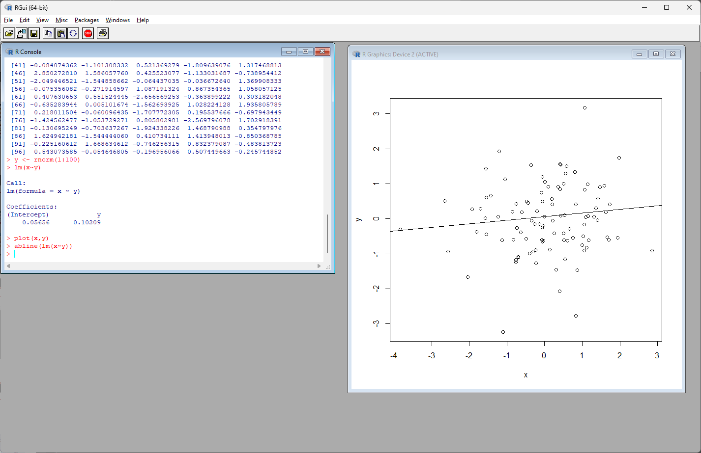
What is R?
Console
Outputs
R v.4.3.0

Slide 5
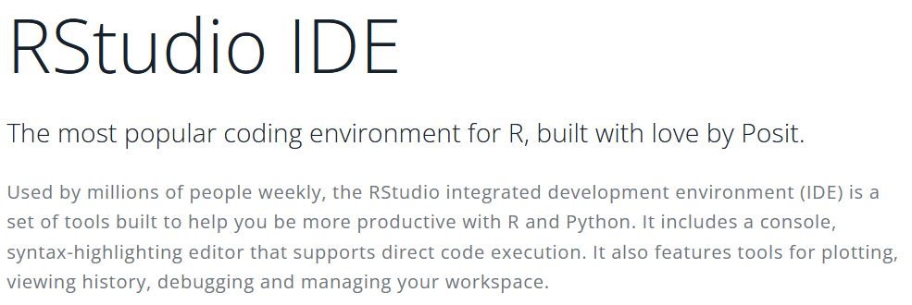
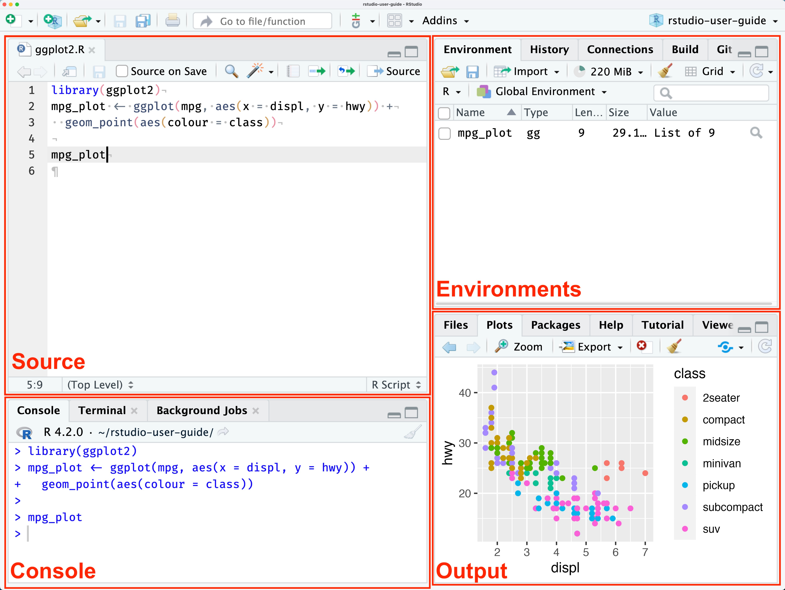
What is R?
Text editor with syntax-highlighting editor

Slide 6
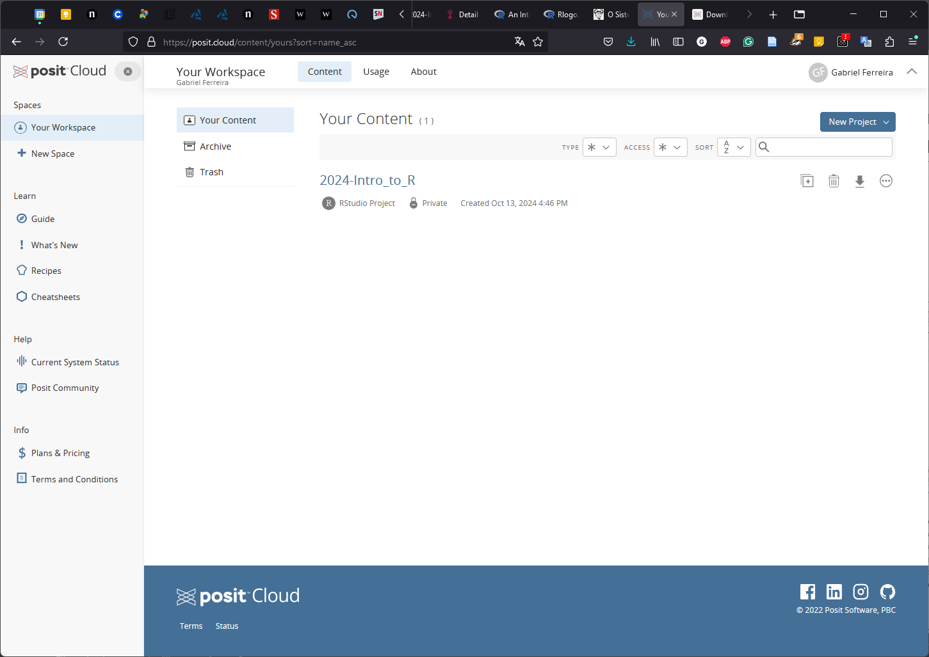
What is R?
http://posit.cloud

Slide 7
Learning goals & course structure
When learning a new language we need a base (the basics — the alphabet, the phonemes, and some very basic vocabulary — is difficult to learn by yourself), resources to go further (such as dictionaries), and practice.
A programming language is no different.
I will cover the basics and present some resources for you to get help in the first three sections, and then we will practice. We will use an overarching project and problem-solving to learn new “vocabulary” and practice your new skill.

Slide 8
Learning goals & course structure
Intro Module
Project-based Module
Basic structure of RStudio
How to get help
Scripting and console
R projects
Basic syntax
Basic math operations
Types of objects
Vector calculations
Installing packages
Functions
Reading your own data
Perform quick data inspection via summary functions
Subsetting your data
Saving your data (tables and R space / RData)
“For loops”, “if/else” statements
How to create and save functions
Basics of plotting -> saving as PDF, PNG, TIFF
Using Quarto
Basic statistics: t-tests
Basic statistics: correlations
Basic statistics: regressions
Data ordination: PCA
Dealing with distributions: box plots
Dealing with distributions: histograms
Dealing with distributions: ANOVA
Dealing with Nas
Maps in R (https://modtools.wordpress.com/)
Phylogenies in R
Guided practice
Self-guided practice
1 week
3 weeks

Slide 9
Learning goals & course structure
The goal of this course is:
You feel comfortable with R and feel capable of finding out how to use it for your own projects

Slide 10
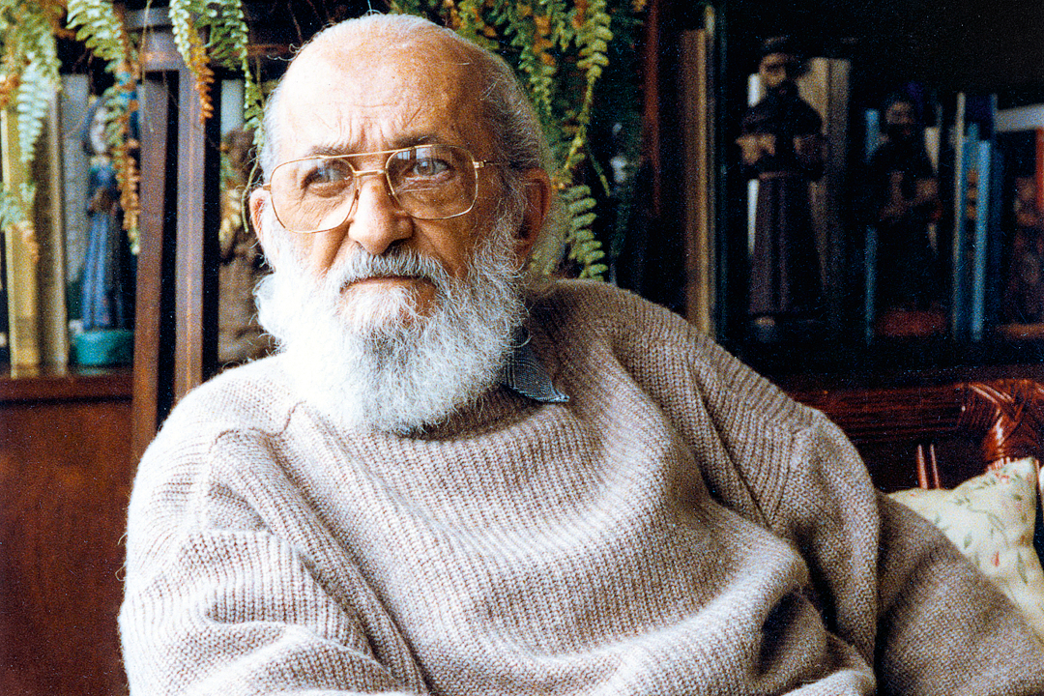
Learning goals & grades
Banking model
Active learning
Teacher = depositor (active), thinks, teaches, knows everything
Students = vessel (passive), listen, are taught, knows nothing
Students are spectators, whose minds are passively open to receive knowledge
Receive, memorize, and repeat
Learning topics that are useful
Tutor = poses and gives support on solving problems, teaches & learns
Students = solve problems, dialogue, discuss among peers, learn & teach
Tutor and students create knowledge together
Students actively work on solving problems and learn through this experience.
Learning topics that are meaningful
The classroom is a space for asking questions, a space of cognition, not information.
Students also develop skills secondary to the main topic, such as knowledge acquisition, group collaboration and communication
Paulo Freire [1921 – 1997]

Slide 11

Learning goals & grades
What is the fundamental reason we go to school/university?
Learning
- Coercion is not the best way to facilitate learning
- Assessment should be in the service of learning, and not the other way around
- Harmful (paralyzing, counterproductive) perfectionism is often the outcome of this culture

Slide 12
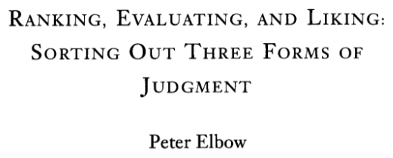

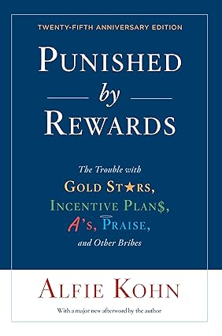
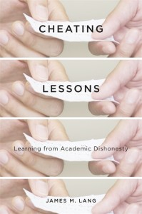
Learning goals & grades
- Tests & assessments become the goal
(1993)
- Grades are not incentive nor feedback, they encourage competitiveness (and they are biased; Malouff & Thorsteinsson (2016). Australian Journal of Education)
- “Research show three reliable effects when students are graded: They tend to think less deeply, avoid taking risks, and lose interest in learning itself”
- “between 60 and 70 percent of students admitted cheating”
- Grading increases stress in students. Heissel et al. (2021). Education Finance and Policy

Slide 13
Learning goals & grades
This project will be graded by you (self-assessment grading)
You tell me the grade you believe is fair given what you learned. I will not discuss your grade, you will assess yourself.
Do not be afraid of giving yourself 1.0!!

Slide 14
Learning goals & grades
Let’s start
Go to: https://github.com/gsferreirabio/2025_26-IntroR

